Slide 1
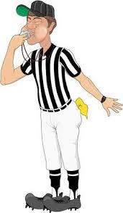


2025 Nevada State Football Championships
Notes:
On Behalf of your 2025 SNOA Football Board, we want to say Congrats to all.

Slide 2
Expectations of Officials in Playoff Games.
1. Professionalism / Composure
Maintain calm, confident body language regardless of the intensity.
Treat coaches, players, game management, and fellow officials with respect always.
Do not let your emotions dictate decisions—it’s a high-stakes environment, but judgment must remain objective.
Notes:
Everyone wants these assignments, But you all were selected, And we have confidence in you and your officiating ability.

Slide 3
2. Rule Knowledge & Consistency
Apply rules accurately and consistently throughout the entire game.
Be prepared for rare or unusual situations that may arise more frequently in playoff scenarios. Expect the Unexpected.
Use proper penalty enforcement mechanics—and administration, everyone has a role, clock status.
Notes:
Poor Preparation will lead to a poor performance. Please step it up a notch and let's give these kids the best we got.

Slide 4
3. Crew Communication and Teamwork
Communicate clearly and efficiently on the field and during dead-ball periods.
Support crew members when needed and trust each official’s primary keys and responsibilities.
Meet pregame expectations regarding:
Coverage and positioning
Game-changing play philosophy
Unusual situations (onside kicks, fair catch, momentum, fouls on scoring plays, etc.)
Notes:
You might be working with officials from other parts of the state and other crews. Be the BEST crew mate you can be.

Slide 5
4. Game Management
Set the tone early with presence and control. It’s ok to smile.
Use preventive officiating when appropriate, but do not coach players or warn excessively.
Know escalation steps for:
Unsportsmanlike conduct/Coaches
Sideline management
Fight potential and post-play action
Notes:
We can’t let the game get out of control.

Slide 6
5. Stay Focused
Give full concentration from opening kickoff to final whistle.
Finish every play with eyes on players who may engage in late or unnecessary actions.
Move with a purpose, maintaining proper angles instead of simply running fast. Trust your training.
Notes:
Be the best dead ball official you can be. Head on a swivel.

Slide 7
6. Safety and Sportsmanship
Prioritize player safety on contact involving:
Targeting / illegal helmet contact/ Flagrant acts
Hits on defenseless players
Action near boundary lines
Address taunting, dead-ball contact, and retaliatory behavior immediately, racial slurs.
Notes:
Player Safety trumps everything. Let’s always protect the student athletes.

Slide 8
7. Appearance and Preparedness
Uniform must be clean, pressed, and look presentable. Come dressed business casual to game.
Clean shaven ( it will grow back)
Arrive on time (or early) and be ready for:
Crew pregame meeting
Working with other officials
Study 7-man mechanics
Notes:
No Jeans, No shorts, No T shirts, Look Professional in your uniform.

Slide 9
8.Media, Fans and External Interaction, Locker rooms
No engagement with spectators or media.
Any requests from the media for statements should go through the
NIAA Executive Director.
Social Media
Respect the Officials locker room
Notes:
PROTECT THE SNOA SHIELD

Slide 10
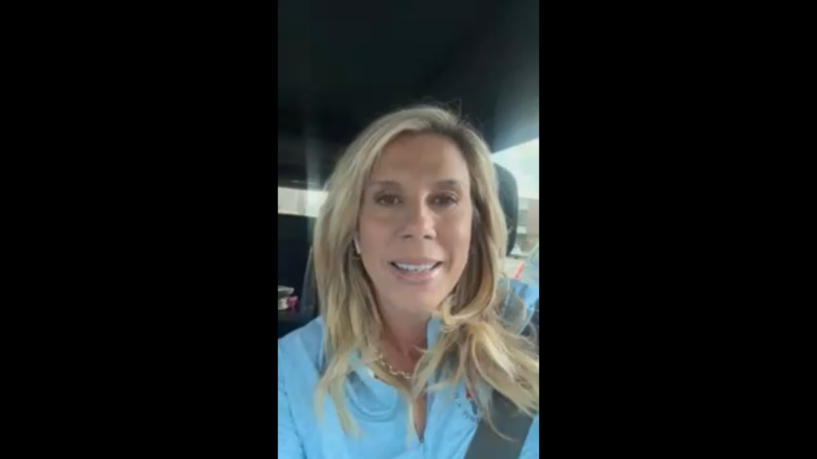
CONGRATULATIONS

Slide 11
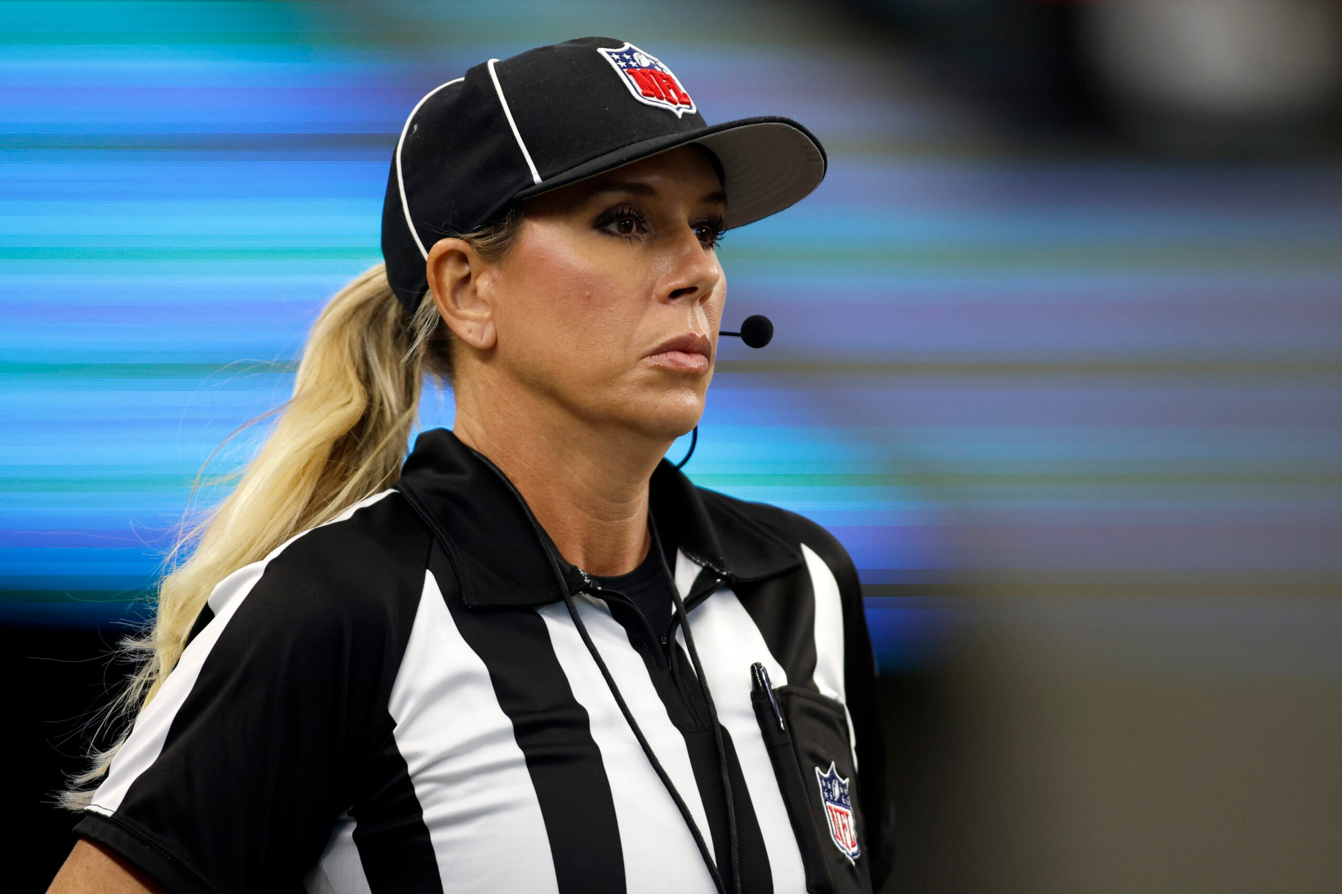
Let’s Do This

